Slide 1
Construction of GANTT Chart from Project Schedule

Slide 2
GANTT Chart
A type of bar chart that illustrates a project schedule.
A project management tool commonly used to schedule tasks.
Named after its inventor, Henry Gantt (1861–1919), who designed such a chart around the years 1910–1915.
One of the most popular and useful ways of showing activities (tasks or events) displayed against time.
It is a chart on which -
Each task/activity is represented by a bar.
The position of each bar reflects the start time and end time of the task/activity.
The length of each bar represents the relative length (Duration) of the task/activity.

Slide 3
GANTT Chart
In a two-dimensional GANTT chart –
A suitable time scale is indicated on the horizontal axis/dimension in terms of days or weeks or months or even years.
A description of activities/tasks makes up the vertical axis/dimension.
GANTT chart allows the user to visualize the following things at a glance:
Various activities/tasks of the project
Start time and end time for each activity/task
Duration of each activity
Overlapping areas between activities and also the amount of overlapping time period
Start time, end time and the overall duration of the whole project

Slide 4
GANTT Chart Examples
Activity | Predecessor | Duration (Days)
A | None | 4
B | None | 2
C | A | 5
D | B | 3
E | C, D | 6
A
From the GANTT chart, it is visible that the project starts at 0 and ends at 15.
So, total project duration is 15 - 0 = 15 Days
B
Activity
C
D
E
Days
0
1
2
3
4
5
6
7
8
9
10
11
12
13
14
15
16

Slide 5
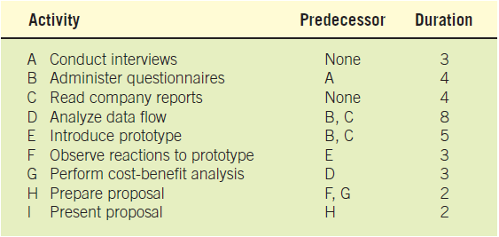
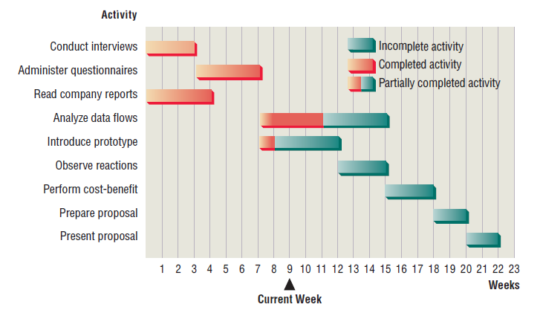
GANTT Chart Examples

Slide 6
Advantages of GANTT Chart
Simple and easy to use.
Lends itself to worthwhile and effective communication to the end users especially for the non-technical people.
Bars are drawn to scale, that is the size of the bar indicates the relative duration for each task.
Disadvantages of GANTT Chart
Difficult to identify the precedence order.
Difficult to identify the critical activities and thus the critical path of the project.
Difficult to determine the slack time.

